Slide 1

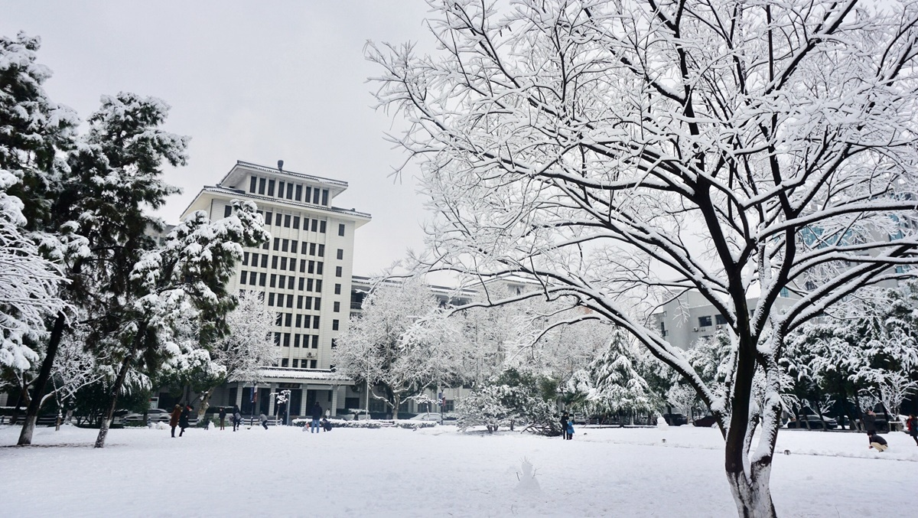
Food waste
on our campus
汇报小组：Group G
汇报人：

Slide 2
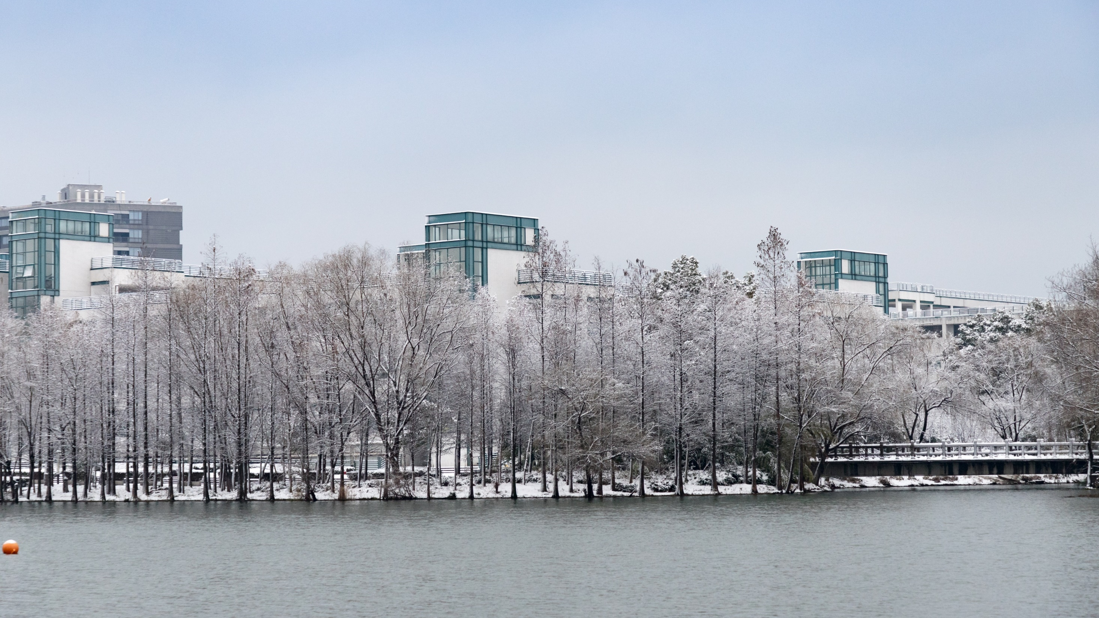

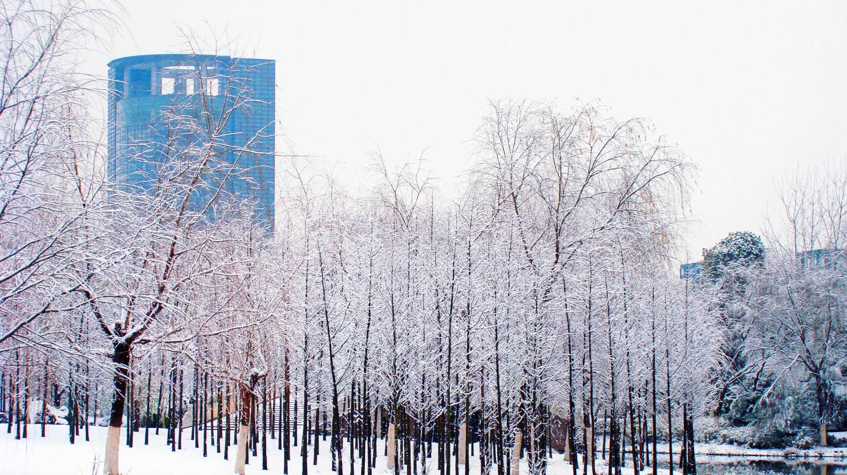
1
Phenomenon
2
Identify the causes
3
Discuss strategies
content
4
Conclusion

Slide 3

Phenomenon

Slide 4
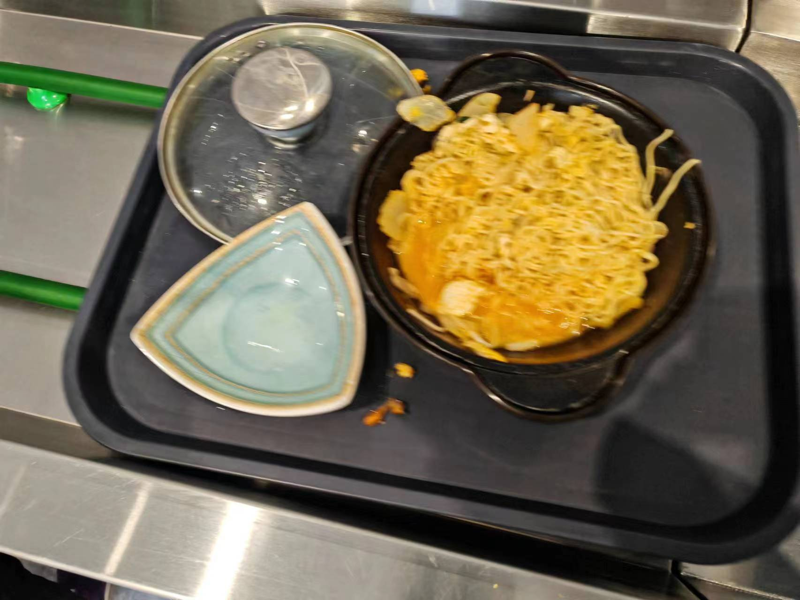
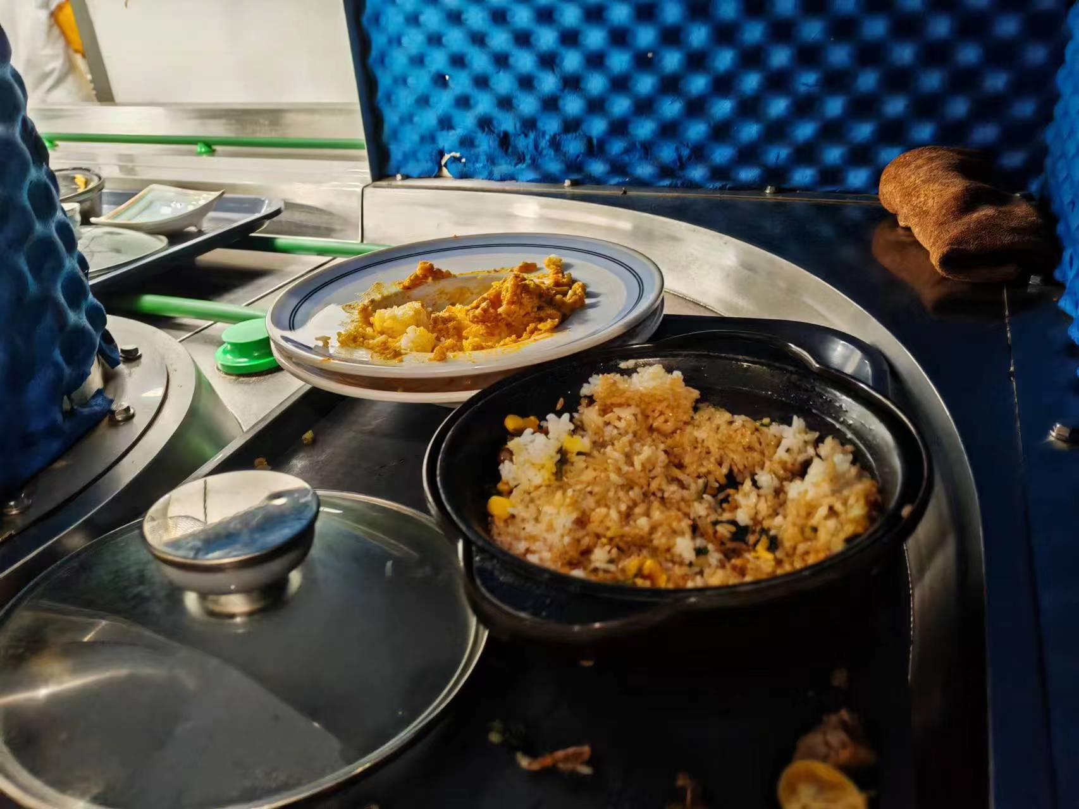
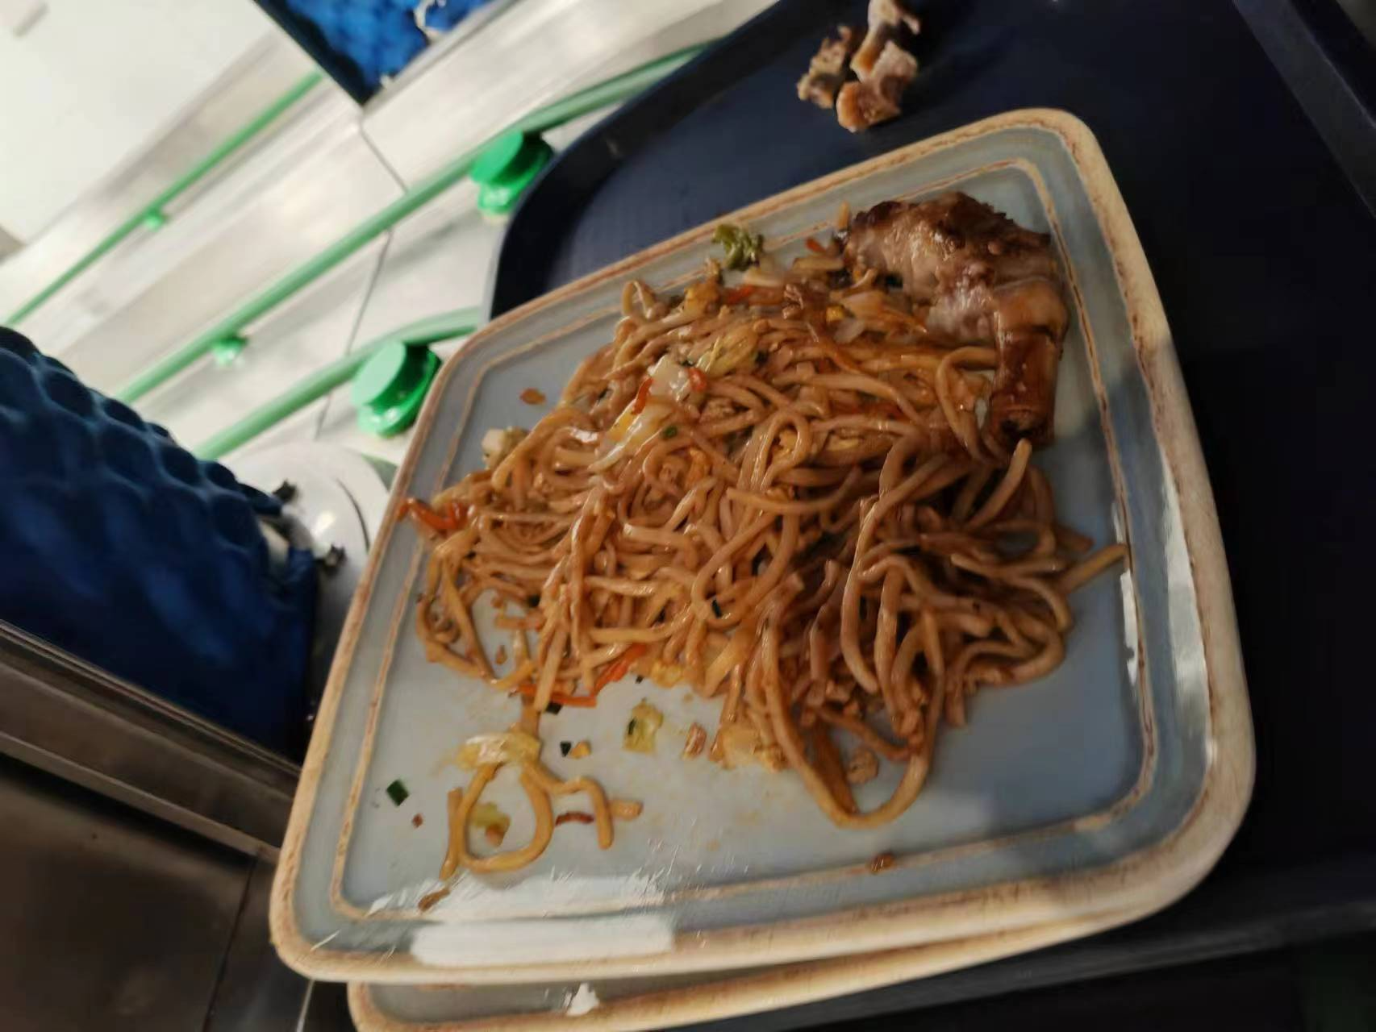
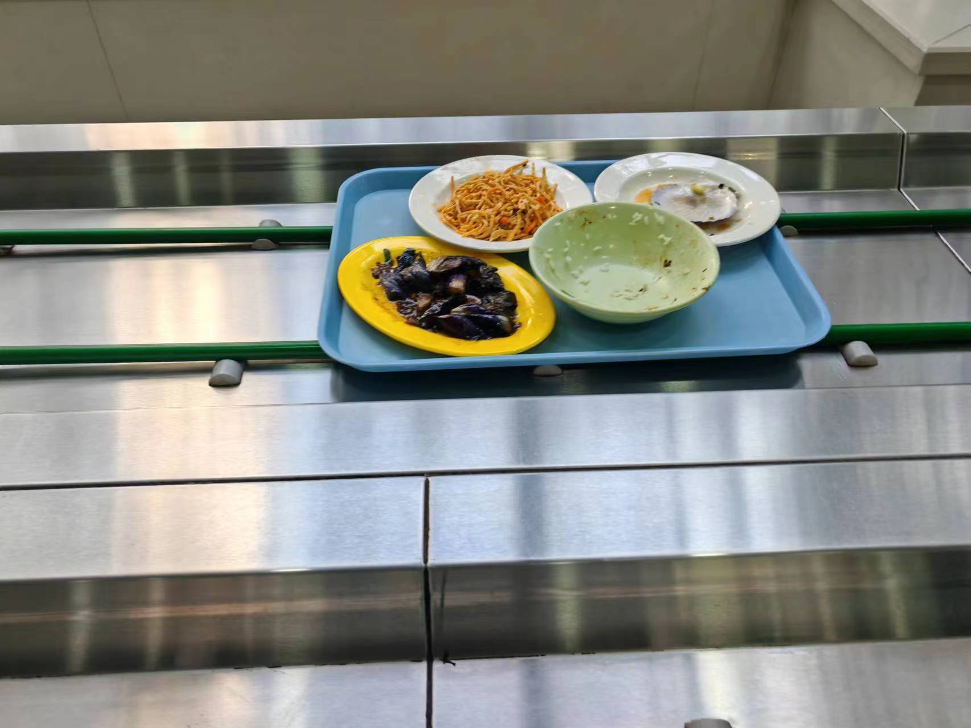
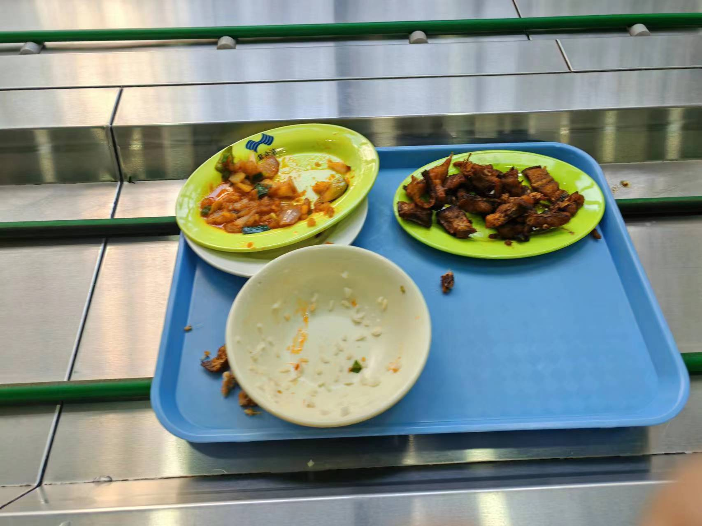

Slide 5
探究紫金港校园食物浪费现象表
剩余菜量 | 数目
基本光盘（剩余菜量10%以下） | 181
略有浪费（剩余菜量超过10%不到25%） | 31
比较浪费（剩余菜量超过25%不到50%） | 7
非常浪费（剩余菜量超过50%） | 9

Slide 6
Identify the causes

Slide 7
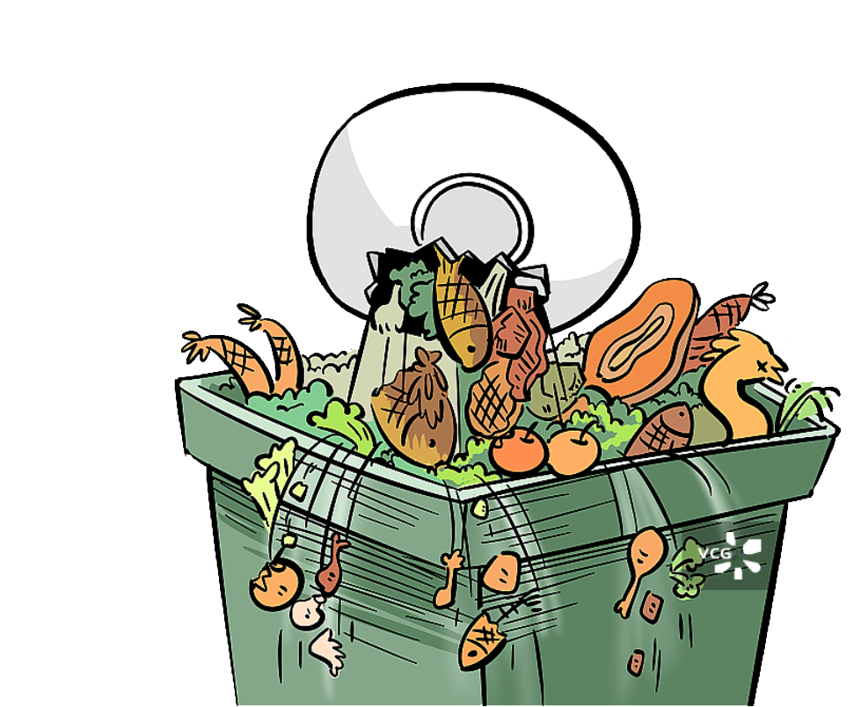
why do we college students waste too much food?

Slide 8


Why?
Take it for granted

Slide 9
Why?
areas difference
School’s food taste not good
limited cost
cooking skills

Slide 10
Objective Reasons for Food Waste
Subjective reasons
Objective
reasons
While the subjective factor of insufficient awareness among consumers regarding food waste is the primary cause of wastage, we must acknowledge that some objective factors also contribute to food waste.

Slide 11
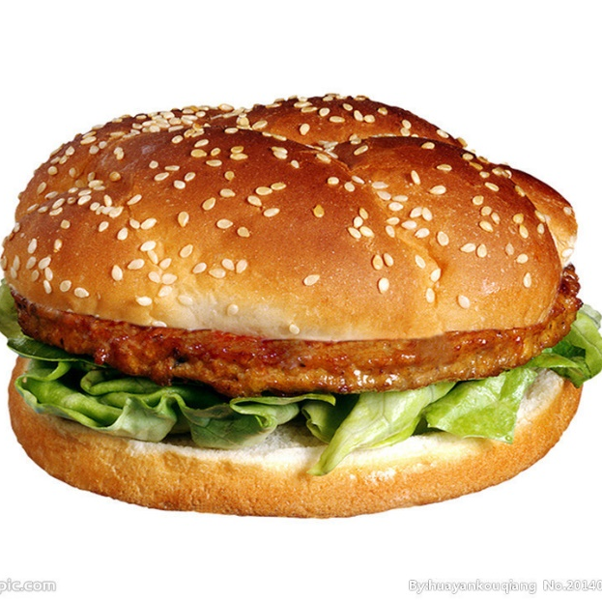
Let's imagine we walk into a cafeteria and order a hamburger.
what you anticipated：

Slide 12
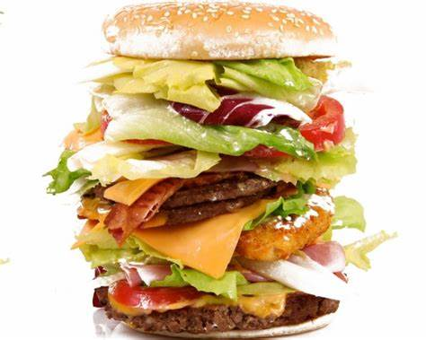
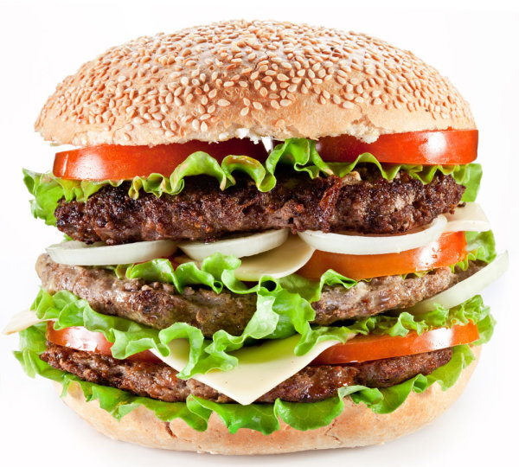
However，what you get maybe like this：

Slide 13
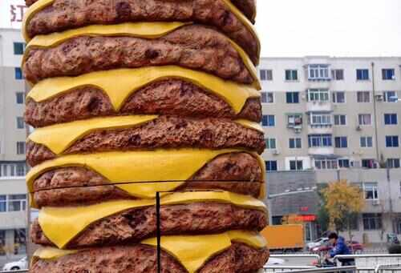
Or this：

Slide 14
Objective reason 1 ：
Oversized Portions in Food Services:
Restaurants and food services may provide oversized portions, making it challenging for customers to consume all of it.
In such situations, consumers find themselves compelled to waste a portion of the food.

Slide 15
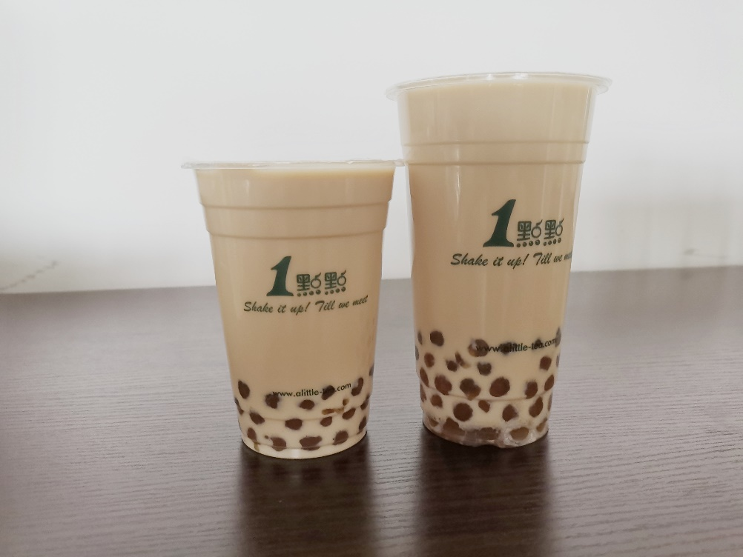
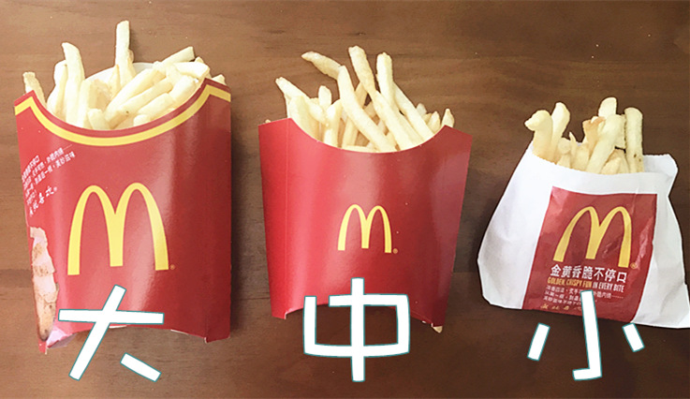
Objective reason 2 ： lack of portion options
In most cases, when we enter a restaurant, we find that many dishes are available in different portion sizes.

Slide 16


Different individuals have different food requirements, and some cafeterias may not offer food in different portion sizes, inevitably causing some people to not get enough to eat, while others end up with more than they can consume.
This is also a significant factor contributing to food waste.

Slide 17


Nevertheless, these objective reasons cannot overshadow the subjective reasons of consumers. Therefore, addressing the issue of food waste requires joint efforts from both consumers and cafeterias.

Slide 18

Discuss strategies

Slide 19

How to deal with the Food Waste
Now we have learnt about some reasons why the food waste is popular
And we should also know how to tackle this problem

Slide 20
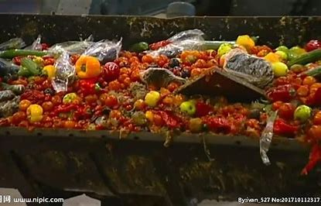
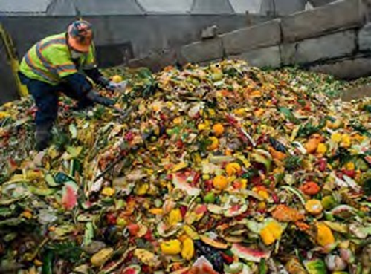
Propagate the severity of food waste
Make people realize the serious situation
Every year, the food we wasted can support nearly 50million people
M49 code¹ | Country | Household food waste estimate (kg/capita/year) | Household food waste estimate (tonnes/year)
156 | China | 64 | 91 646 213
344 | China, Hong Kong SAR | 71 | 531 023
446 | China, Macao SAR | 71 | 45 731
408 | Dem. People’s Rep. Korea | 81 | 2 070 528
392 | Japan | 64 | 8 159 891
496 | Mongolia | 78 | 250 173
410 | Republic of Korea | 71 | 3 658 024

Slide 21




Educate people to save food

Slide 22
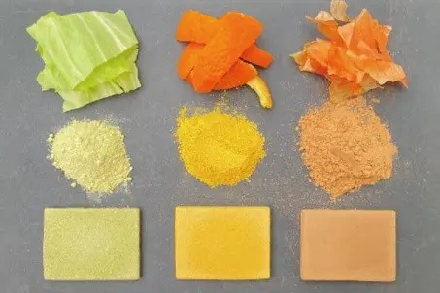
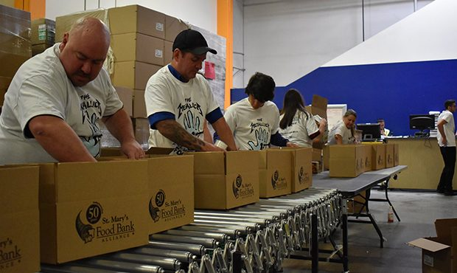
Take full advantage of the food
New technologies can change food to compost,methane and even plastic
The famous charity organization Food Bank is thriving

Slide 23
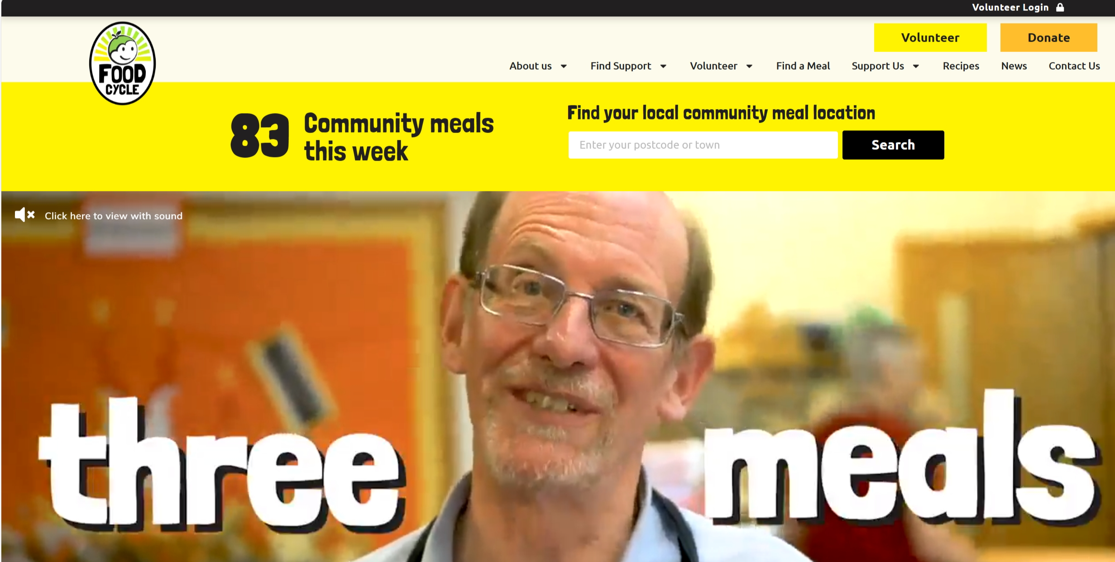


Take full advantage of the food
FOODCYCLE
change trash to treasure

Slide 24

Economize on meals
Individuals can pay attention to their own dining needs and only order what they can finish to avoid excessive leftovers.

Slide 25

Sharing food
preventing food waste caused by ordering too much individually.
explore various types of food and reduce waste from individual over-ordering.

Slide 26
Conclusion

Slide 27

Take action against food waste.
All of above is just talking if we don’t take action.
As individual, we can take action first and every small step counts.
Together, we can reduce the food waste and create a more sustainable future.

Slide 28
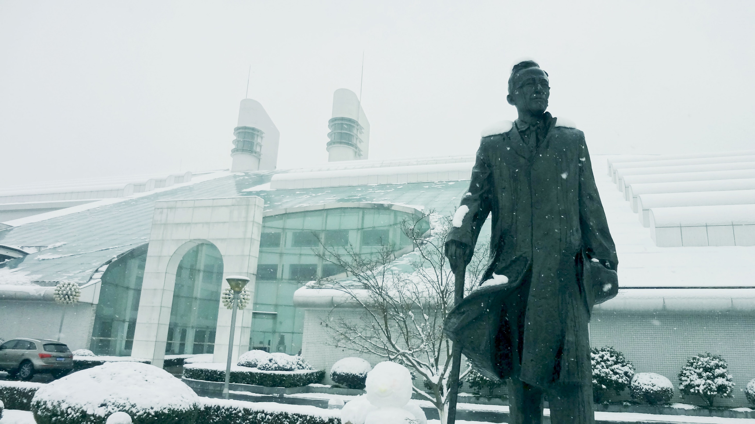

Thanks

